Slide 1
Why We Needed More Than K-Means
In this module, we first understood the fundamental limitations of K-Means clustering that make it insufficient for many real-world scenarios.
Spherical Assumption Problem
Fixed Cluster Requirement
Noise Sensitivity Issue
Every point must belong to a cluster, meaning outliers and noise distort results rather than being identified separately.
K-Means assumes clusters are spherical and similar in size, failing when data forms irregular, elongated, or nested shapes.
The number of clusters must be specified in advance, forcing decisions before understanding the data's natural structure.
Key insight: Real-world data is messy, irregular, and often noisy. Relying only on K-Means can lead to misleading clustering results that miss the true structure hidden in your data.

Slide 2


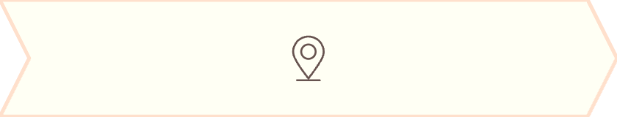
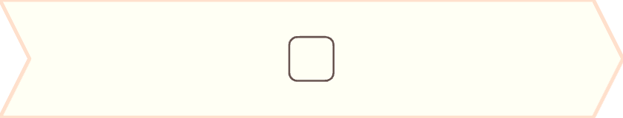
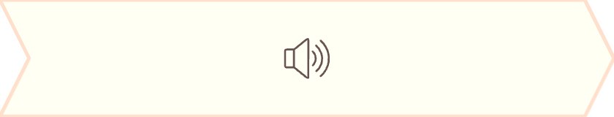
DENSITY-BASED APPROACH
What We Learned from DBSCAN
DBSCAN introduced a fundamentally different way of thinking about clustering, moving away from centroids to density-based grouping.
Density-Defined Clusters
Noise Recognition
Arbitrary Shapes
Clusters form naturally in dense regions, not around fixed centers
Sparse or isolated points are explicitly treated as noise, not forced into clusters
Can detect clusters of any shape, including irregular and nested patterns
Core Parameters
eps: Defines neighborhood radius around each point
min_samples: Ensures meaningful density thresholds
Core Points
Border Points
Noise Points
Dense neighborhood centers that anchor clusters
Edge members connecting to core points
Isolated outliers excluded from clusters
Key takeaway: DBSCAN does not force every point into a cluster. It respects the structure already present in the data, making it ideal for real-world messy datasets.

Slide 3
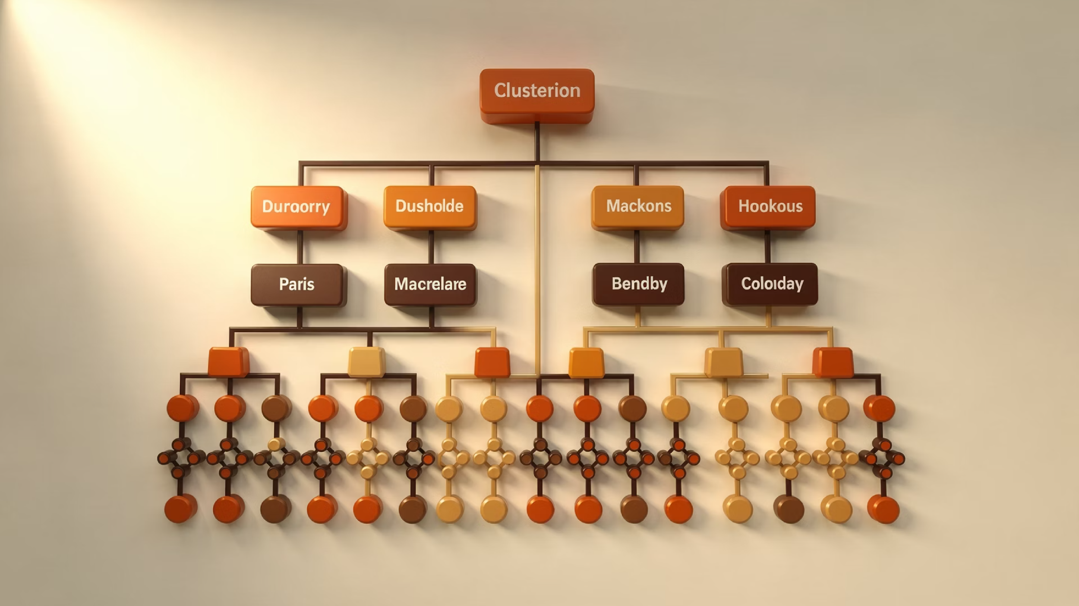

STEP-BY-STEP STRUCTURE
What We Learned from Hierarchical Clustering
Hierarchical Clustering revealed how clustering can be built progressively, preserving the entire merging history for deeper structural insight.
Individual Points
Gradual Merging
Full History
Start: each data point is its own cluster
Clusters combine based on distance metrics
Complete merging process is preserved
Linkage Methods
The Dendrogram Advantage
Single linkage: Minimum distance between clusters
Visualizes the complete clustering hierarchy, allowing you to choose the optimal number of clusters by cutting the tree at different heights.
Complete linkage: Maximum distance between clusters
Average linkage: Average distance across all pairs
Ward linkage: Minimizes within-cluster variance
Key strength: Hierarchical clustering prioritizes interpretability and structural insight over speed.

